Slide 2
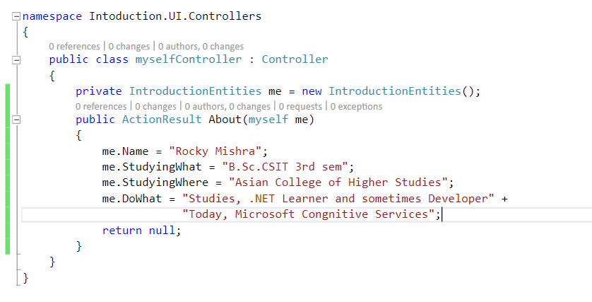

Slide 3
Cognitive Services Build smarter, more engaging experiences with knowledge & intelligence services from Microsoft.

Slide 4

Cognitive Services
Vision
From faces to feelings, allow your apps to understand images and video
Microsoft Cognitive Services
Give your apps a human side
Speech
Hear and speak to your users by filtering noise, identifying speakers, and understanding intent
Language
Process text and learn how to recognize what users want
Search
Access billions of web pages, images, videos, and news with the power of Bing APIs

Slide 5







Why Microsoft Cognitive Services ?
Easy
Flexible
Tested
Roll your own with REST APIs
Simple to add: just a few lines of code required
Make the same API code call on iOS, Android, and Windows
Integrate into the language and platform of your choice
Built by experts in their field from Microsoft Research, Bing, and Azure Machine Learning
Quality documentation, sample code, and community support
GET A KEY
BUILD

Slide 6

Cognitive Services
microsoft.com/cognitive
Vision
Speech
Language
Knowledge
Search
Computer Vision
Custom Recognition
Bing Spell Check
Academic Knowledge
Bing
Web Search
Emotion
Speaker Recognition
Linguistic Analysis
Entity Linking
Bing
Image Search
Face
Speech
Language Understanding
Knowledge Exploration
Bing
Video Search
Video
Translator
Text Analytics
Recommendations
Bing
News Search
WebLM
Bing
Autosuggest

Slide 7
Bing

Slide 8













Bing beyond search in bing.com
Smarter, more engaging experiences
Trusted by industry-leading experiences
apple

Slide 9
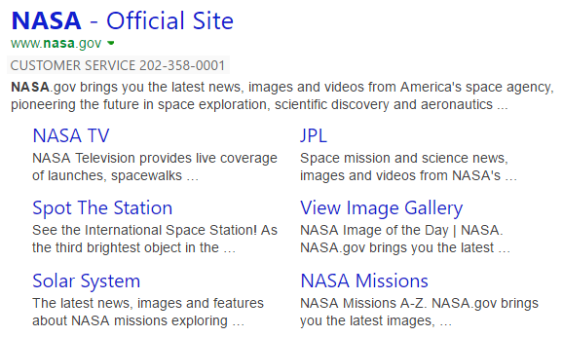

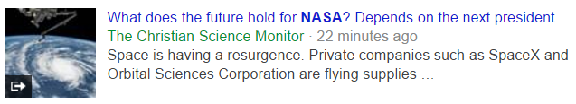
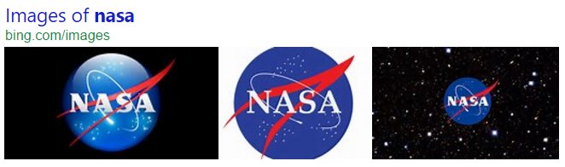
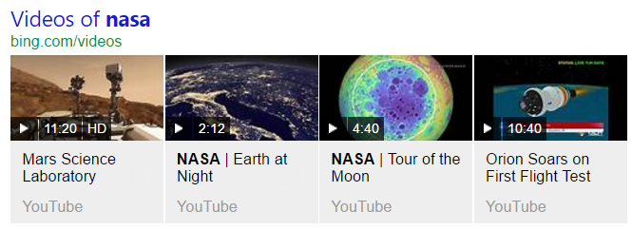
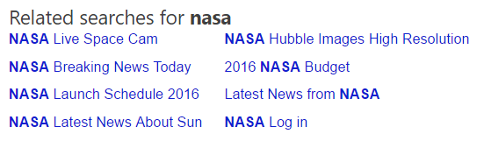
Web Search API
Web Search API
Get relevant web and answer results and metadata with one API call
https://bingapis.azure-api.net/v5/search?q=nasa
Web
Results
Search Response
Deep Links
(1st Algo)
{
“_type”: “SearchResponse”,
“queryContent”: {…},
“webPages”: {…},
“news”: {…},
“images”: {…},
“videos”: {…},
“relatedSearches”: {…},
“rankingResponse”: {…}
}
News Results
Ranking Response
Image
Results
{
“answerType”:”WebPages”,
“resultIndex”:0,…
},
{
“answerType”:”News”,
“resultIndex”:1,…
}
Video Results
Related Searches
*screenshots show actual search results on bing.com

Slide 10

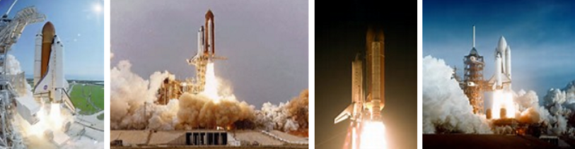

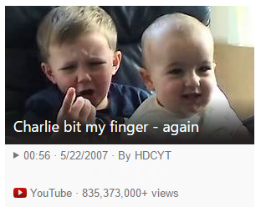

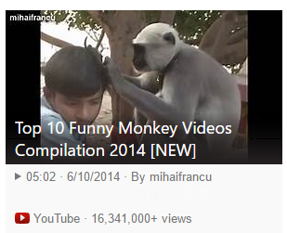

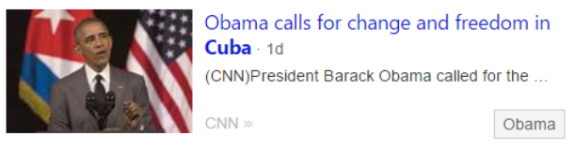
Vertical Search APIs
Get more results, features and metadata tailored to each search vertical
Image Search API
https://bingapis.azure-api.net/v5/images/search?q=shuttle+launch
Enhanced metadata and filters (size, license, style, freshness, color)
Image insights (entity recognition, visually similar)
source: nasa.gov
Video Search API
https://bingapis.azure-api.net/v5/videos/search?q=viral+videos
Enhanced metadata and filters (price, resolution, length, freshness)
Motion thumbnails (video preview)
source: youtube.com
News Search API
https://bingapis.azure-api.net/v5/news/search?q=cuba
News by category/market, and trending news
Rich article metadata (featured entities)
source: cnn.com
*screenshots show actual search results in bing.com

Slide 11
Computer Vision

Slide 12
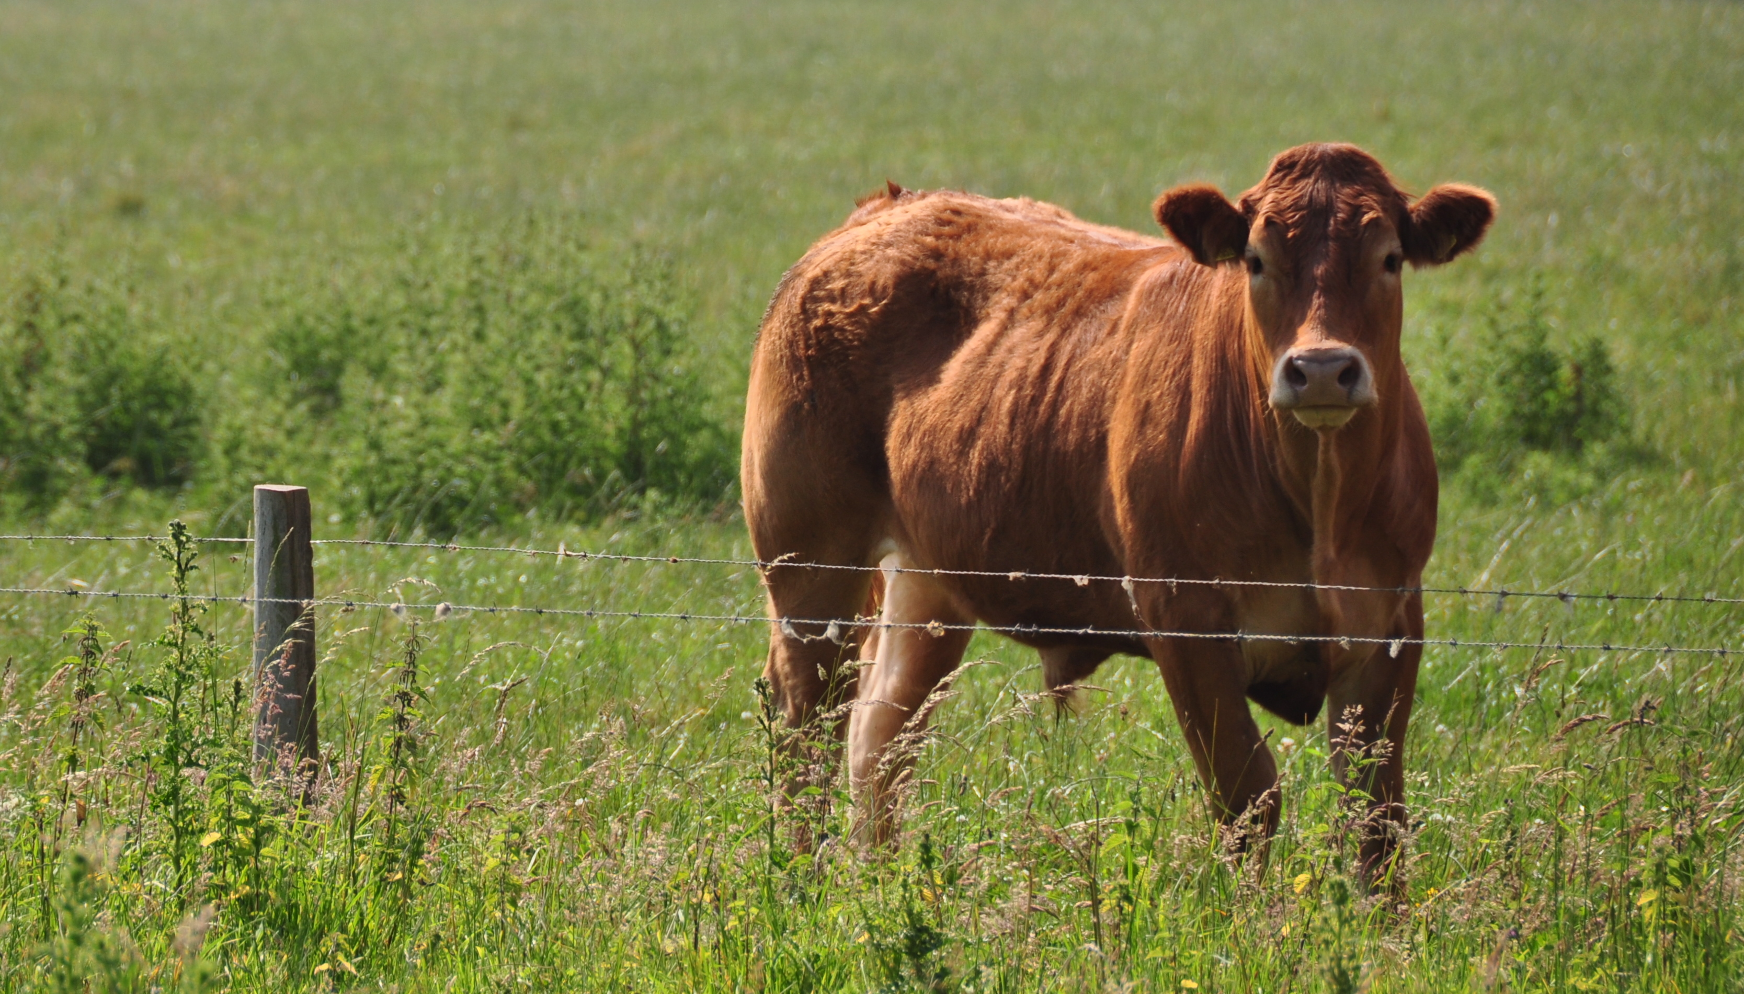
Updated Computer Vision API
Content of Image:
Categories v0: [{ “name”: “animal”, “score”: 0.9765625 }]
V1: [{ "name": "grass", "confidence": 0.9999992847442627 },
{ "name": "outdoor", "confidence": 0.9999072551727295 },
{ "name": "cow", "confidence": 0.99954754114151 },
{ "name": "field", "confidence": 0.9976195693016052 },
{ "name": "brown", "confidence": 0.988935649394989 },
{ "name": "animal", "confidence": 0.97904372215271 },
{ "name": "standing", "confidence": 0.9632768630981445 },
{ "name": "mammal", "confidence": 0.9366017580032349, "hint": "animal" },
{ "name": "wire", "confidence": 0.8946959376335144 },
{ "name": "green", "confidence": 0.8844101428985596 },
{ "name": "pasture", "confidence": 0.8332059383392334 },
{ "name": "bovine", "confidence": 0.5618471503257751, "hint": "animal" },
{ "name": "grassy", "confidence": 0.48627158999443054 },
{ "name": "lush", "confidence": 0.1874018907546997 },
{ "name": "staring", "confidence": 0.165890634059906 }]
Describe
0.975 "a brown cow standing on top of a lush green field“
0.974 “a cow standing on top of a lush green field”
0.965 “a large brown cow standing on top of a lush green field”

Slide 13
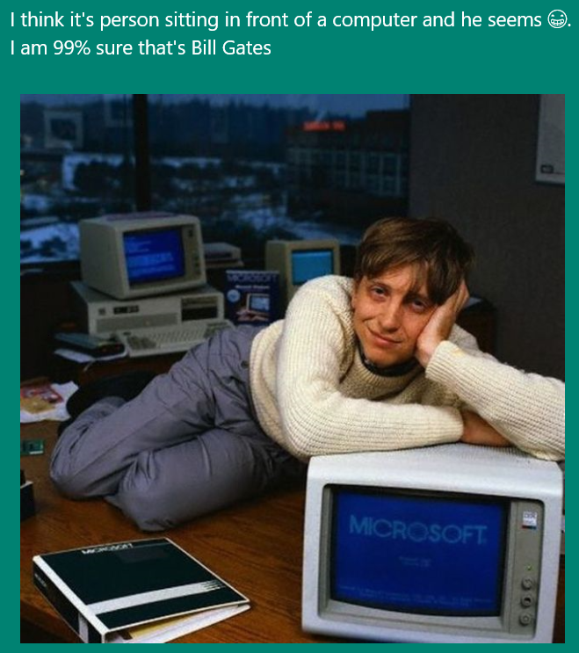
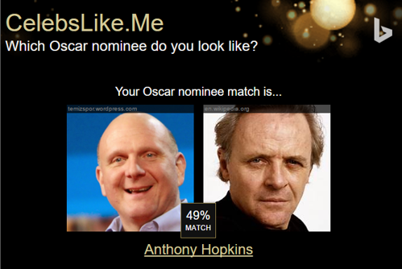
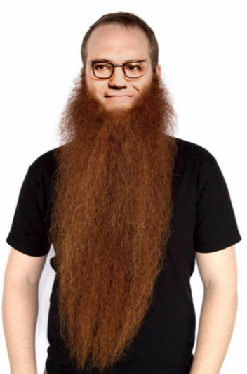
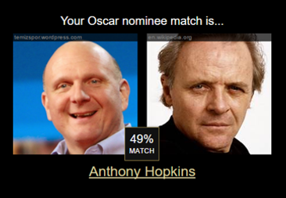
Apps Powered by MS Cognitive Services
I think it’s a person sitting in front of a computer and he seems ☺. I am 99% sure that’s Bill Gates
CaptionBot.ai
Celebslike.me
ProjectMurphy.net

Slide 14
Demo
microsoft.com/cognitive
Start coding

Slide 15
Developer Call to Action
Sign up and get started today for free at www.microsoft.com/cognitive
Train your bot at
https://www.luis.ai/

Slide 16
Questions?

